Slide 1
HNCEA
The Huron North Community Economic Alliance is a regional, grassroots organization made up of communities along the north shore sharing a vision of growing economic prosperity.

Slide 2
Brief Overview
Introductions
Member listing
Community Investment Initiative for Northern Ontario (CIINO) deliverables
  12 month work plan
Update and EDO activities

Slide 3
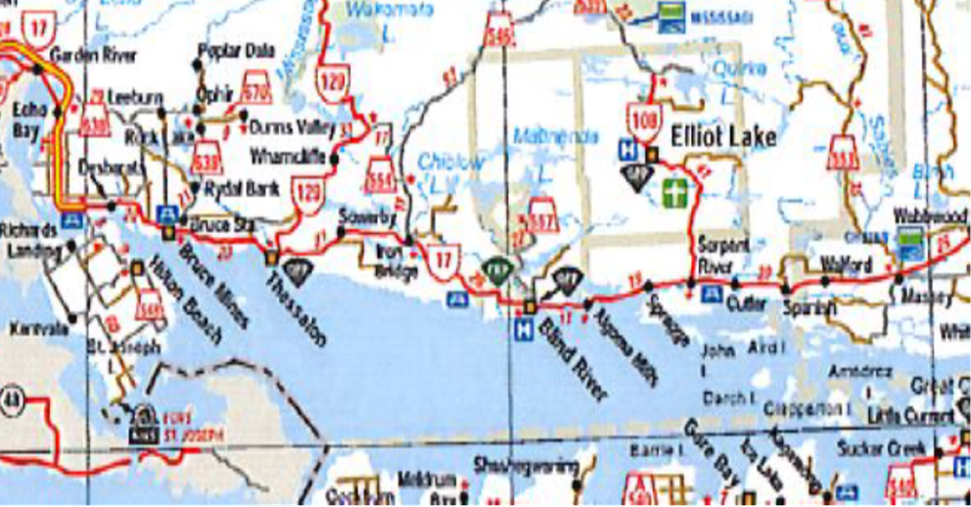
Members
Blind River
Bruce Mines
Elliot Lake
Hilton Beach
Huron Shores
Jocelyn
Johnson
MacDonald, Meredith & Aberdeen
Mississauga FN
Plummer Additional
Serpent River FN
Spanish
Tarbutt
The North Shore
Thessalon, and
Thessalon FN
200 km east to west
Combined population of 33,153
Land area 52, 000 sq km
According to MNRF, there are more moose per square km then people.

Slide 4
HNCEA
Huron North Community Economic Alliance
Mission: to provide a regional and collaborative alliance that promotes economic growth of its communities by coordinating and implementing economic development projects
Vision: for our communities to work together for regional prosperity
Objectives: identify regional needs, encourage and support existing organizations and opportunities, recognize and build on resources, address gaps and initiate, promote and manage regional economic initiatives, initiate and support local and regional self-determination

Slide 5
CIINO
HNCEA attained CIINO funding with your member contributions.
HNCEA leverages 90 cents on the dollar for a total grant of $510,000 for a $566,000 project.
The project allows for 2 economic development officers until 2023.
Our work plan is built around the FedNor deliverables
The deliverables in our current 12 month work plan are:
  Record keeping, First Nation and municipal relations, local target sectors, Hosting Workshops, Workforce Development, and Communication
Notes:
HNCEA successfully attained CIINO funding with your member contributions. HNCEA was able to leverage 90 cents on the dollar for a total grant of $510,000 for a $566,000 project.
The project allows for 2 economic development officers until 2023. Emilie is located in the Blind River office and Aaron is in the Johnson office. We also meet and work at satellite office spaces available from our membership communities.
Our work plan is built around the FedNor deliverables which are gone into in further details in your handout
The deliverables being addressed in the first 12 month work plan are:
Record keeping, First Nation and municipal relations, local target sectors, Hosting Workshops, Workforce Development, and Communication

Slide 6
CIINO deliverables and activities to date
Implementing Business Opportunities in Agriculture
  Sector meetings
Business and product development in Tourism
  Sector meetings
Developing community investment attraction strategy
  Investment Readiness Test for communities
  Website and business directory
Workforce Development
  In collaboration with AWIC
Training services and workshops
Notes:
Assist with implementing business opportunities in the agriculture sector as identified by the HNCEA sector group
Buy local, produce to market, regional value chain support such as a abatoire and address current challenges
Work with RAIN regarding a Agri-Food Open for Business
Fall agriculture sector forum – had a reschedule the planned spring event because of Covid
Assist in initiating business and product development activities in the tourism sector
Presently working on a developmental plan for local businesses to assess their market readiness and address new trends in the tourism sector.
Aaron, talk about the tourism and the need to work with the amazing tourism partners - build the content to sell the town, projects to build bridges between the land initiatives and campaigns and the water initiatives and campaigns working seamlessly to prompt the best of both to each other. Show your graphic as a great first step of knowing the players, knowing what each brings to the table could be the springboard project with similar messaging.
Strocking with boom camp trails, golf course – tourism partnerships and packaging.
Developing agri-tourism strategies in the region in partnership with Buy Algoma Buy Local
Planning a virtual town hall for tourism operators as well as businesses dependent on tourism to share concerns and plan a xxxxx.
Organizing meetings with tourism operators and businesses dependent on tourism to help develop local marketing products
Working with Destination Northern Ontario and the Algoma Kinniwabi Travel Association (AKTA) to develop and market local tourism products and marketing materials; and to offer training and capacity development locally
We understand that investment readiness requires a collaborative and that the communities in our region benefit from economic growth in their neighbours.
We will be beginning the investment readiness plan and attractions strategy by reaching out to members and working with them to complete the Government of Ontario’s Investment Readiness Test. Invitations for participation to be in the next 2 weeks and plan on completing the exercise with our member communities by the end of July. From this test we hope to get a better picture of how prepared our communities are for investors so that we can build a regional investment attraction strategy.
We built a HNCEA website with business directories broken out by sector with links to our member community home pages. This also supports the local community businesses. The website is almost ready, we are still ‘debugging’ and ‘fine tuning’ the site, we are hoping to have a soft launch next week
There are significant demographic trends that will affect local businesses and the communities and the Covid situation has changed the workforce and our understanding of it.
Initial discussions have taken place and it has been determined that a workforce attraction and retention project will be more effective when we are able to work face to face with partners. In the meantime, a virtual town hall for tourism and service sector businesses is being planned in partnership with AWIC.
Training services and workshops
We are working with regional resources to organize training and workshops The project we submitted an application for CAP funding with a workshop component. Online training webinars will focus on e-business readiness, customer experience, e-Marketing and supporting businesses in creating an e-Commerce platform.

Slide 7
Additional projects: Broadband
Not covered under our contract with FedNor
A significant subject that supports member communities
Gaps have been emphasized by the pandemic
HNCEA’s role:
Broadband Task Group
Broadband Advisory Committee
Notes:
Although Broadband is not covered under our contract with FedNor, we felt as though it is an important component of economic development in the north and is a significant infrastructure project that supports our member communities and our HNCEA population.
In November of 2019, a Broadband Task Group (BTG) was put together by HNCEA to explore options regarding broadband funding that had just been released by the CRTC. The BTG worked collaborative with the Sault Ste Marie Innovation Centre (SSMIC) to utilize their technical expertise.
The BTG put out an RFP for service providers to help them get a better idea of what would be required to meet the minimum CRTC requirements of 50mbps/10mbps across the entire Huron North region.
In February of 2020, 2 proposals were received in response to the RFP. The proposals received highlighted the infrastructure needs and the cost. As well, the technical assessment from SSMIC determined that the technology needed was not readily or easily available.
The proposals also demonstrated that a Broadband project is a multi million dollar project. It was not feasible in February to attain within 6 to 8 weeks a financial and project commitment from our municipalities and FN. The financial commitment will be significant and there will be a need to inform and communities of the technology – this a task that requires project planning and could not be done within weeks in March.

Slide 8
Building Partnerships
Ensuring organizations are active in the area
Working towards mutual goals for the region
Examples:
  Sault Ste. Marie Innovation Centre
  Algoma Kinniwabi Travel Association
  Rural-Agri Innovation Centre
  Algoma Workforce Investment Corporation
  Millworks Centre for Entrepreneurship

Slide 9
Alignment with the Township of Plummer Additional Strategic Economic Development Goals (2012)
Better positioning the tourism sector (consider removing)
Better positioning the agriculture sector
Investment readiness
Broadband internet infrastructure
Achieving efficiency through carrying out economic development projects as a region

Slide 10
Questions?
Contact us:
emilie.currie@hncea.ca
aaron.millette@hncea.ca

